Slide 1
SUPPLY CHAIN & SALES PERFORMANCE
Global Mart & Supermart
Dashboard Project
A Power BI report tracking revenue, profitability, and operational reliability across Africa
Power BI · DAX · HTML Content Visuals

Slide 2
OVERVIEW
Project Overview
1
Two Dashboards, One Story
Sales Performance and Supply Chain & Operations, built as a single connected report.
DASHBOARD 1
Sales Performance
2
Fully Filterable
Revenue · Profit · Category & Region
Slice by Region, Year (2023 vs 2024), and Product Category to drill from company-wide to warehouse-level.
3
Built for Self-Service
DASHBOARD 2
Custom KPI cards and visuals let stakeholders explore without needing a data analyst.
Supply Chain & Ops
Delivery · Suppliers · Warehouses
Global Mart & Supermart | Power BI Dashboard Project
2

Slide 3
THE CHALLENGE
Business Problem
Sales, warehouse, and supplier data live in disconnected systems — making simple questions hard to answer quickly and consistently.
Which regions & products drive revenue vs. profit?
Are shipments reliable and on time?
Which suppliers & warehouses perform best?
Is profit actually growing year-over-year?
Result: reactive decisions on inventory, supplier contracts, and regional strategy — without a single source of truth.

Slide 4
GOALS
Project Objectives
1
Consolidate sales & supply chain data into one report
2
Track revenue, profit & margin at every level
3
Monitor delivery reliability & damaged goods
4
Benchmark supplier & warehouse performance
5
Enable year-over-year growth comparisons
6
Deliver a self-service, filterable interface
Global Mart & Supermart | Power BI Dashboard Project
4

Slide 5
DATA
Datasets
S
Sales / Orders
S
Suppliers
Order ID, Product, Category, Qty, Sales, Profit, Country, Region, Date
Supplier Name, Stock Level, Profit Contribution, Country
W
Warehouses
S
Shipping / Delivery
Warehouse Code, Total Revenue, Total Profit, Prior Year Profit
Days to Ship, Delivery Status, Damaged Goods, Success Rate
Global Mart & Supermart | Power BI Dashboard Project
5

Slide 6
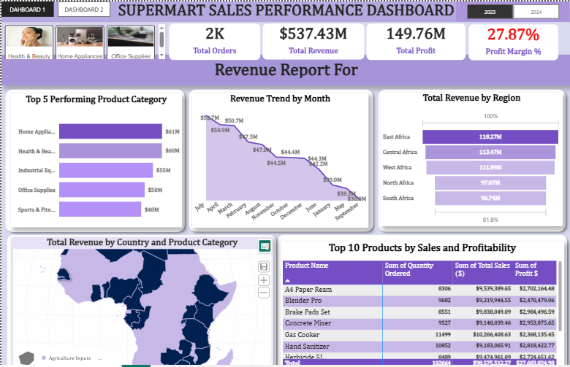
DASHBOARD PREVIEW · 1 OF 2
Sales Performance Dashboard
Revenue, profit & top products by category, region, and country

Slide 7
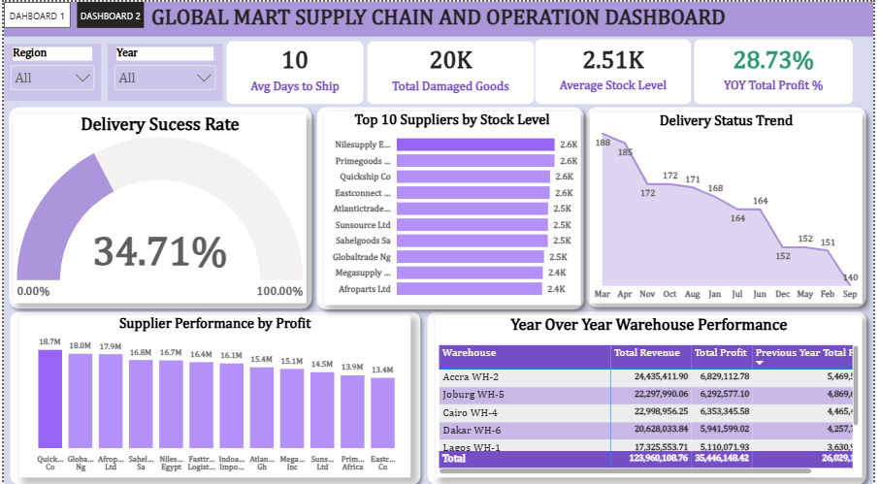
DASHBOARD PREVIEW · 2 OF 2
Supply Chain & Operations Dashboard
Delivery reliability, supplier stock levels, and warehouse YoY performance

Slide 8
PERFORMANCE
KPIs at a Glance
$537.43M
$149.76M
27.87%
2K
Total Revenue
Total Profit
Profit Margin
Total Orders
28.73%
34.71%
10 days
20K
YoY Profit Growth
Delivery Success Rate
Avg. Days to Ship
Total Damaged Goods
Global Mart & Supermart | Power BI Dashboard Project
8

Slide 9
FINDINGS
Business Questions & Insights
Top categories?
Top region?
Home Appliances & Health/Beauty lead, ~$61M & $60M
East Africa leads at $118.27M; North/South Africa trail
Revenue trend?
Delivery reliability?
Peaked in July (~$53.7M), declining steadily since
Only 34.71% success rate, and still falling (188→140)
Best suppliers?
Best warehouse?
Quickship Co & Globaltrade Ng — profit, not just stock
Accra WH-2 leads on both revenue and profit
Global Mart & Supermart | Power BI Dashboard Project
9

Slide 10
SO WHAT?
Business Insight
Growth is real (+28.73% YoY profit) but concentrated in East, Central & West Africa
Delivery is the biggest operational risk — reliability is low and falling
High stock ≠ high profit; some supplier capital is tied up inefficiently
Monthly revenue is decelerating since its July peak — needs root-cause review

Slide 11
ACTION
Strategic Recommendations
1
Audit delivery reliability — carriers, dispatch, infrastructure
2
Shift sourcing toward high-profit suppliers, not just high-stock
3
Invest in North & South Africa to close the regional gap
4
Replicate Accra WH-2's practices across weaker warehouses
5
Investigate the post-July revenue decline by category
6
Reduce damaged goods through packaging & handling review
Global Mart & Supermart | Power BI Dashboard Project
11

Slide 12
WHAT'S NEXT
Future Improvements
Longer-term moves for the business, beyond the immediate recommendations
→
Diversify the logistics network beyond a single carrier
→
Rebalance suppliers toward profitability over volume
→
Pursue targeted growth in North & South Africa
→
Turn top-warehouse practices into a rollout playbook
→
Develop counter-seasonal products to smooth revenue
→
Explore private-label or bundled offerings for margin

